Slide 1
Advanticsys
Machine Learning for anomalies detection in solar plant
Denis Bharatbhai Vaghasia [s3858391]
Joyal Joy Madeckal [s3860476]
Qi Lu [s3302044]
Notes:
Hello everyone, my name is Qi, with my team member Denis and Joy, we have worked on project Advanticsys. in the project, we have used data science approaches and machine learning technologies to detect anomalies in solar plant energy production (20)

Slide 2
Project partner and background
Project Partner : Advanticsys
Partners are specialized in field of data monitoring and system
They provide solutions by providing monitoring and controlling products that enhance services in several industries
Solar power plant consist of set of solar panels connected to inverters which is connected to main powerhouse
Solar power is DC power and with help of inverter, that power is converted to AC

Slide 3
Problem and aim
Objective is to identify potential anomalies if present, in solar plant in the new built Bangalore, India
Partners identified; solar panels does not generate enough energy after some interval
Potential anomalies which can lead to low power generation
Some issues they encountered are : Failed PV module, reduced revenue, reputations damage and more labor cost for inspection
We will achieve with the help of statistical analysis, Machine learning predictions and data visualization through Tableau

Slide 4
Abnormal detection process
Guidance
The more value created the better
Inverters produce enough power that generate revenue are in normal condition
The panels produce low energy will be identified as abnormal
Check performance vs previous production
Abnormal if significantly produce less energy
Check performance vs prediction
Less deviation from prediction
Normal
Produce enough energy
Normal
Check the trend of total energy production identify inverters failing fast
Same failing rate is expected
Notes:
So, how to detect anomalies, since the plant is new built and no benchmark to compare, we follow the guidance that the more value created the better. Inverters produced enough power considered normal. Only panels produce low energy amount will be identified as abnormal. Based on this rule, we made detection in 3 steps. we firstly check current production verse previous periods to find inverters under performed. Secondly, we assessed the correlation between energy production and environment conditions, identify inverters under expectations. In addition, we also reviewed the energy production through time, find which one’s performance declined faster (50s)

Slide 5
Scientific approach
Problem definition
Hypothesis
Test with experiment
Data analysis
Report conclusions
Notes:
To achieve the goal, we took scientific approaches. Based on the problem, we make assumptions, then conduct tests with experiments. Through data analysis and machine learning models application, we can finally provide insights.

Slide 6
Methodology
Data exploration
ML model creation and evaluation
Present results
Statistical analysis
Data cleansing and manipulation
Notes:
To create a functional dashboard, we followed the 5 step procedure start with data cleansing, making statistical analysis, Ml model application and report results (5s)

Slide 7
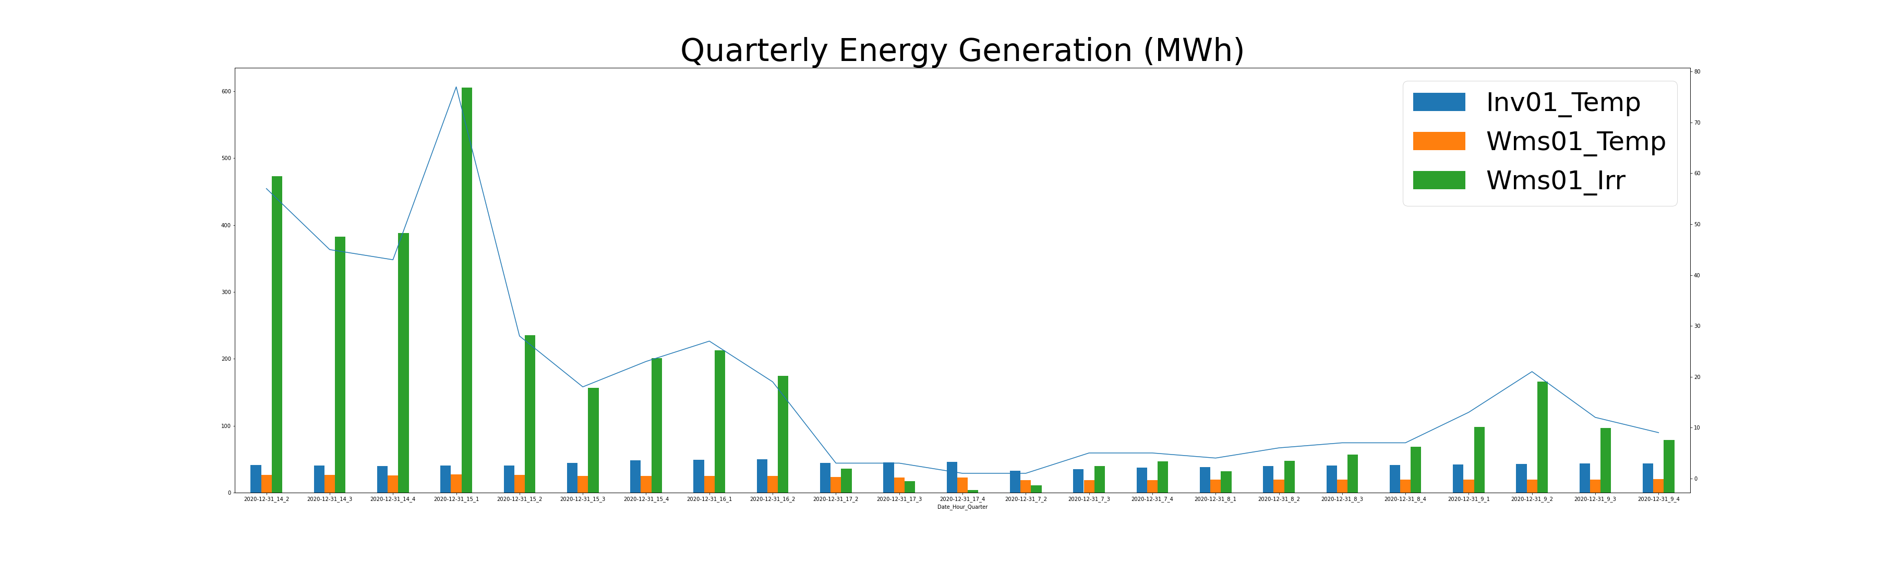
Understanding of Data
Solar plants has 10 clusters of solar panel with 10 inverters
Two and half year data from 2019 to 2021
DC power has gone into inverters is not relevant, only AC power generated by inverters are valuable.
Daily energy production is recorded by minute in kWh
Total energy data shows overall power generation since first operation.
Irradiance level is closely related to energy production, which is recorded in 2 weather monitoring systems on site
Temperature is also relevant to production at some stage
Notes:
The first step in the process was the selection of useful data. The solar plant we were working on has 10 clusters of solar panel with 10 inverters. The dataset provided to us includes a long list of csv files show every detailed information recorded through the plant operation. Not all of them are useful. By discussing with our partner and conducting data exploration, we have filter out the irrelevant data. Identified the features closely relate to each other. Here is an example of data exploration, shows correlations between daily energy production, irradiance level, and temperature recordings (55s)

Slide 8
Data cleaning and manipulation
Every feature mentioned before are in different files, so we merged them into 1 data frame
Eliminated the data values where energy generated is 0
Removed outliers and possible data errors
Converting each minute timeframe data into 15 minutes interval data
Combining clean data into single data frame for subsequent analysis
Notes:
Once all relevant data was selected, the next step was to clean, transform and combine data into a single data frame that could easily be processed by statistical and machine learning models. (14s)

Slide 9
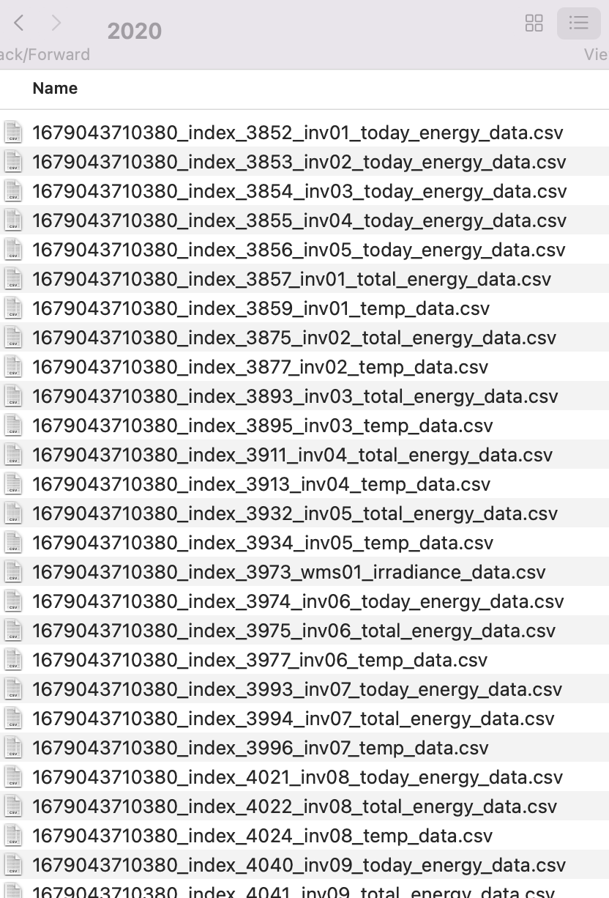
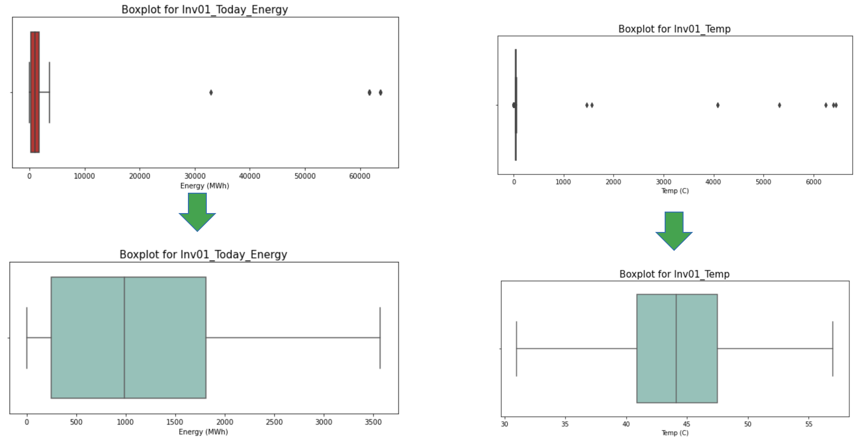
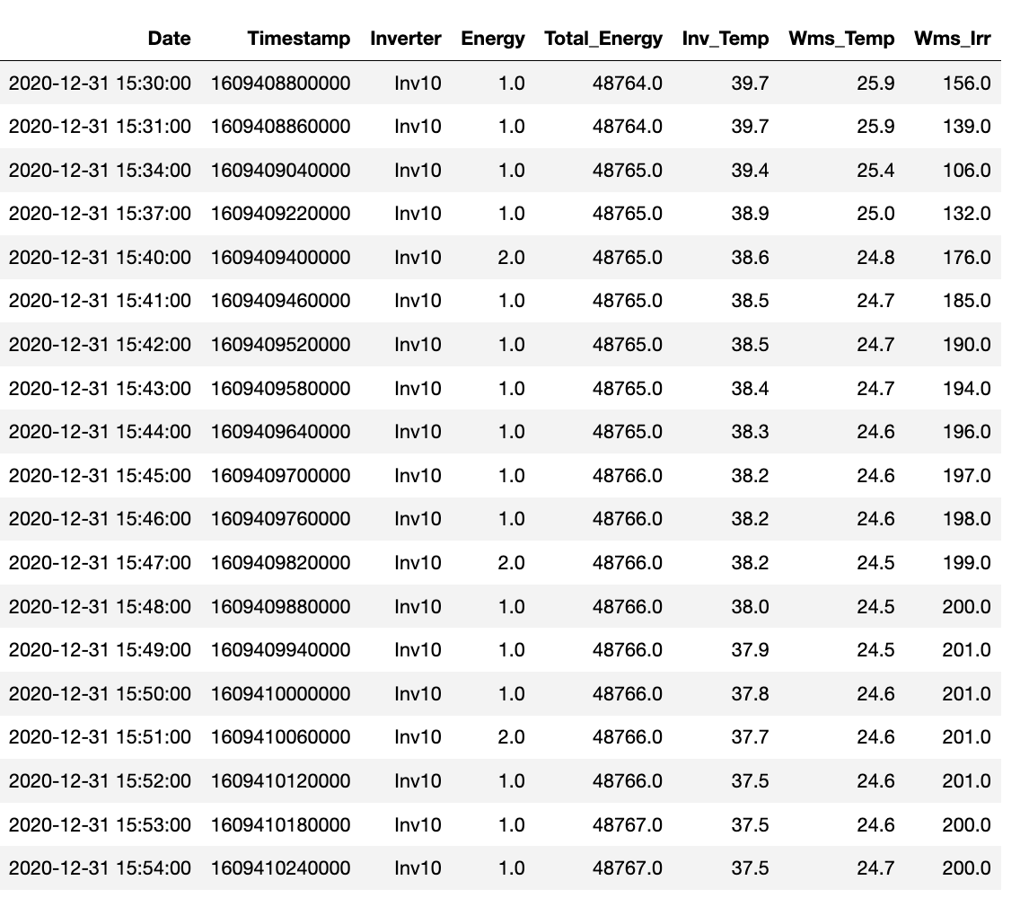
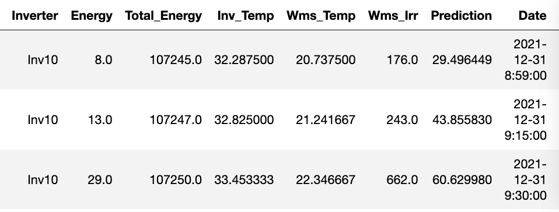
Notes:
During this step, we have removed outliers and possible data errors. Combined data by minute into 15 mins interval for dashboard building (10s)

Slide 10
Statistical analysis
Why statistical model?
Hypotheses testing 1:
Whether the mean of current energy production or irradiance level is significant less than previous period, previous month and previous year
Hypotheses testing 2:
Whether the variance of current irradiance level or energy production is same as previous period, previous month and previous year within 95% confidence interval
Notes:
With clean data, we can apply statistical analysis to identify trends and develop valuable insights. By applying the suitable models, we can prove whether inverters are operating normally scientifically.
The hypotheses tests we conducted include current and previous periods comparison. By doing so, we can get conclusion of inverters produce significantly less energy in a high irradiance level. (35s)

Slide 11
Model Formulation
Deep Cleaning
Isolation Forest
Anomaly detection algorithm
Multi-layer perceptron
Neural network with 3 input nodes, 2 hidden layers and 1 output node
Comparison with Actuals
The percentage deviation from the predicted values will be shown and inferences can be made. (>5% may can be considered as not normal)
Low memory requirement and works with high volume data
The data that is reported as normal will be fed to the next stage.
Make predictions for the energy generated
Inv_Temp
Wms_Temp
Irradiance
Energy Generated
Normal data
Predictions

Slide 12
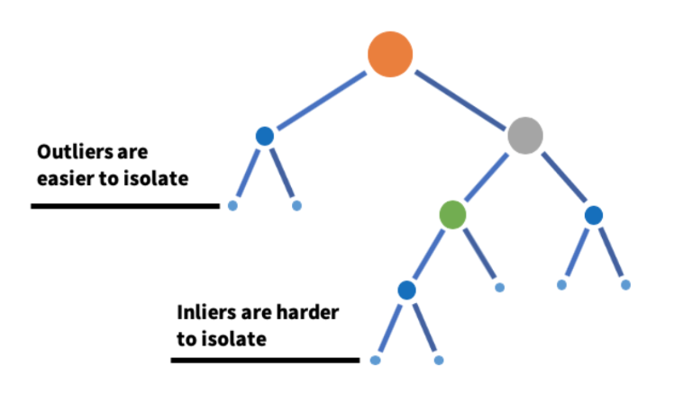
Isolation Forest
Why isolation forest?
As the configuration of the inverters are assumed to be different, there will be 10 different models for each inverter.
Hyperparameter tuning was performed for the models to find the best combination of parameters.
Source: LinkedIn Engineering (Link)

Slide 13
Multi-Layer Perceptron Architecture
Hidden Layers
Inverter Temperature
Irradiance
Energy
Temperature
ReLU
ReLU
Notes:
We are predicting the energy generated in the minute.
ReLU activation function is used since we are predicting a numerical value and as this is not a classification problem.
The thumb rule to decide on the number of hidden layers = (Number of input nodes + number of output nodes)/2
Similarly we have decided the number of hidden nodes and then tuned the model by increasing the number of nodes in the hidden layers.

Slide 14
Multi-Layer Perceptron - Results
Inverter | RMSE
Inv01 | 0.67
Inv02 | 0.62
Inv03 | 0.74
Inv04 | 0.44
Inv05 | 0.52
Inv06 | 0.74
Inv07 | 0.76
Inv08 | 0.77
Inv09 | 0.68
Inv10 | 0.73
10 multi-layer perceptron models were developed
Model training was performed with data from 2020 January to 2021 November.
The predictions are made for 2021 December.
The data is further plugged into the visualization dashboard to get more insights.
Notes:
We are predicting the energy generated in the minute.
ReLU activation function is used since we are predicting a numerical value and as this is not a classification problem.

Slide 15
Final dashboard
4 ways to identify abnormal inverters and support decision making
Visualization - get impression on possible abnormal inverters
Result from statistical analysis on actual data – identify inverters significantly produce less energy in similar or higher irradiance level when compared to previous period
Actual verse prediction summary – find the inverters have actual energy show large deviation from prediction in percentage
Total energy production trend show decline rate - identify inverters decline faster
Notes:
By following the data analysis, model selection and application. We have created a dashboard that provide insights in 4 ways to assist decision making in abnormal investigation and maintenance planning. (15s)

Slide 16
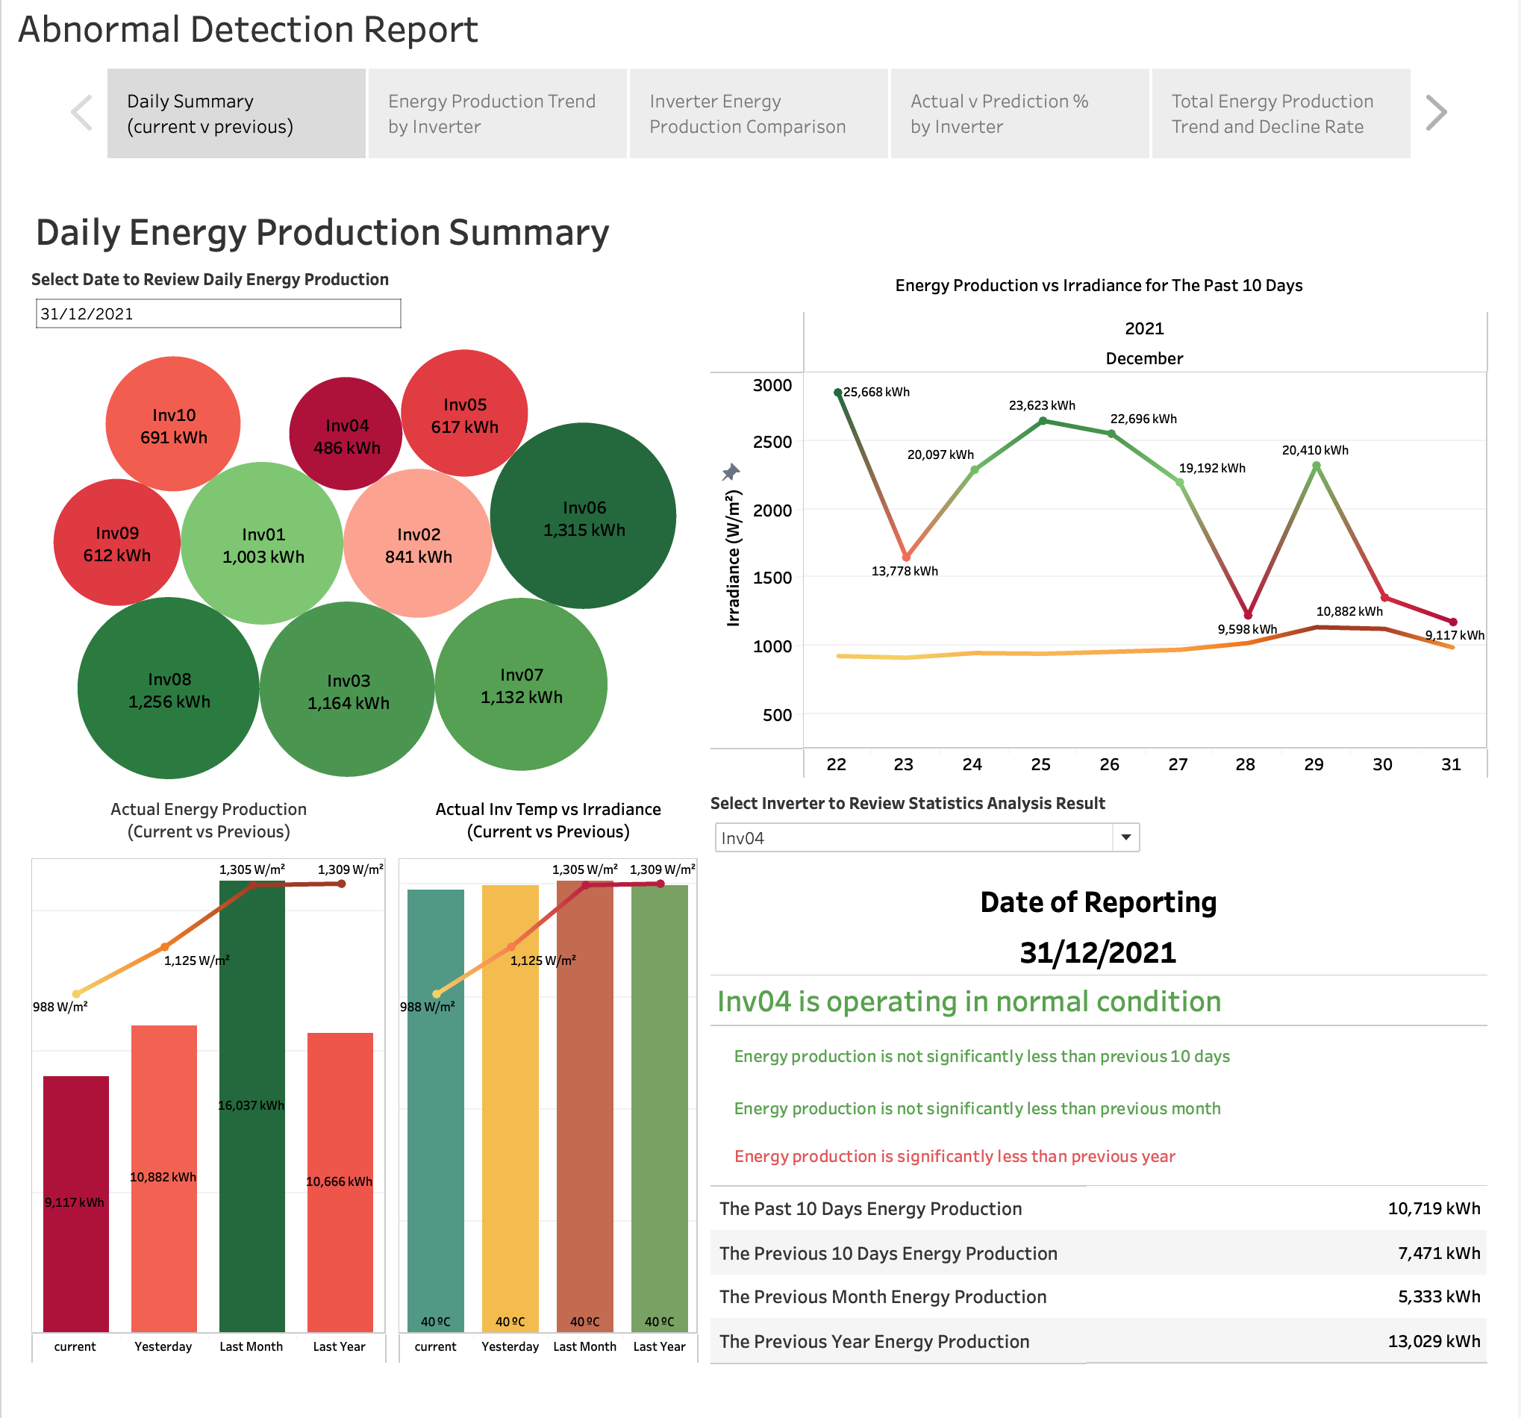
Visualization – Daily summary
Select a date to review energy produced by each inverter
Possible abnormal if high capacity inverter produced less energy
Compare current date energy production with previous periods
review the correlation between energy and irradiance level
Possible abnormal if inverter produced less energy than previous periods at high irradiance level
Notes:
The visualized summary of actual energy production can help users get impression on low performed inverters (7s)

Slide 17
Result from statistical analysis
Select an inverter, the report will show you the outcome from statistical analysis,
If current period is significantly producing less power than previous period with similar or higher irradiance, the report will show the inverter is operating abnormally
Notes:
Moving to next stage, users can check the statistical analysis conclusion to get further proof on inverter condition (8s)

Slide 18
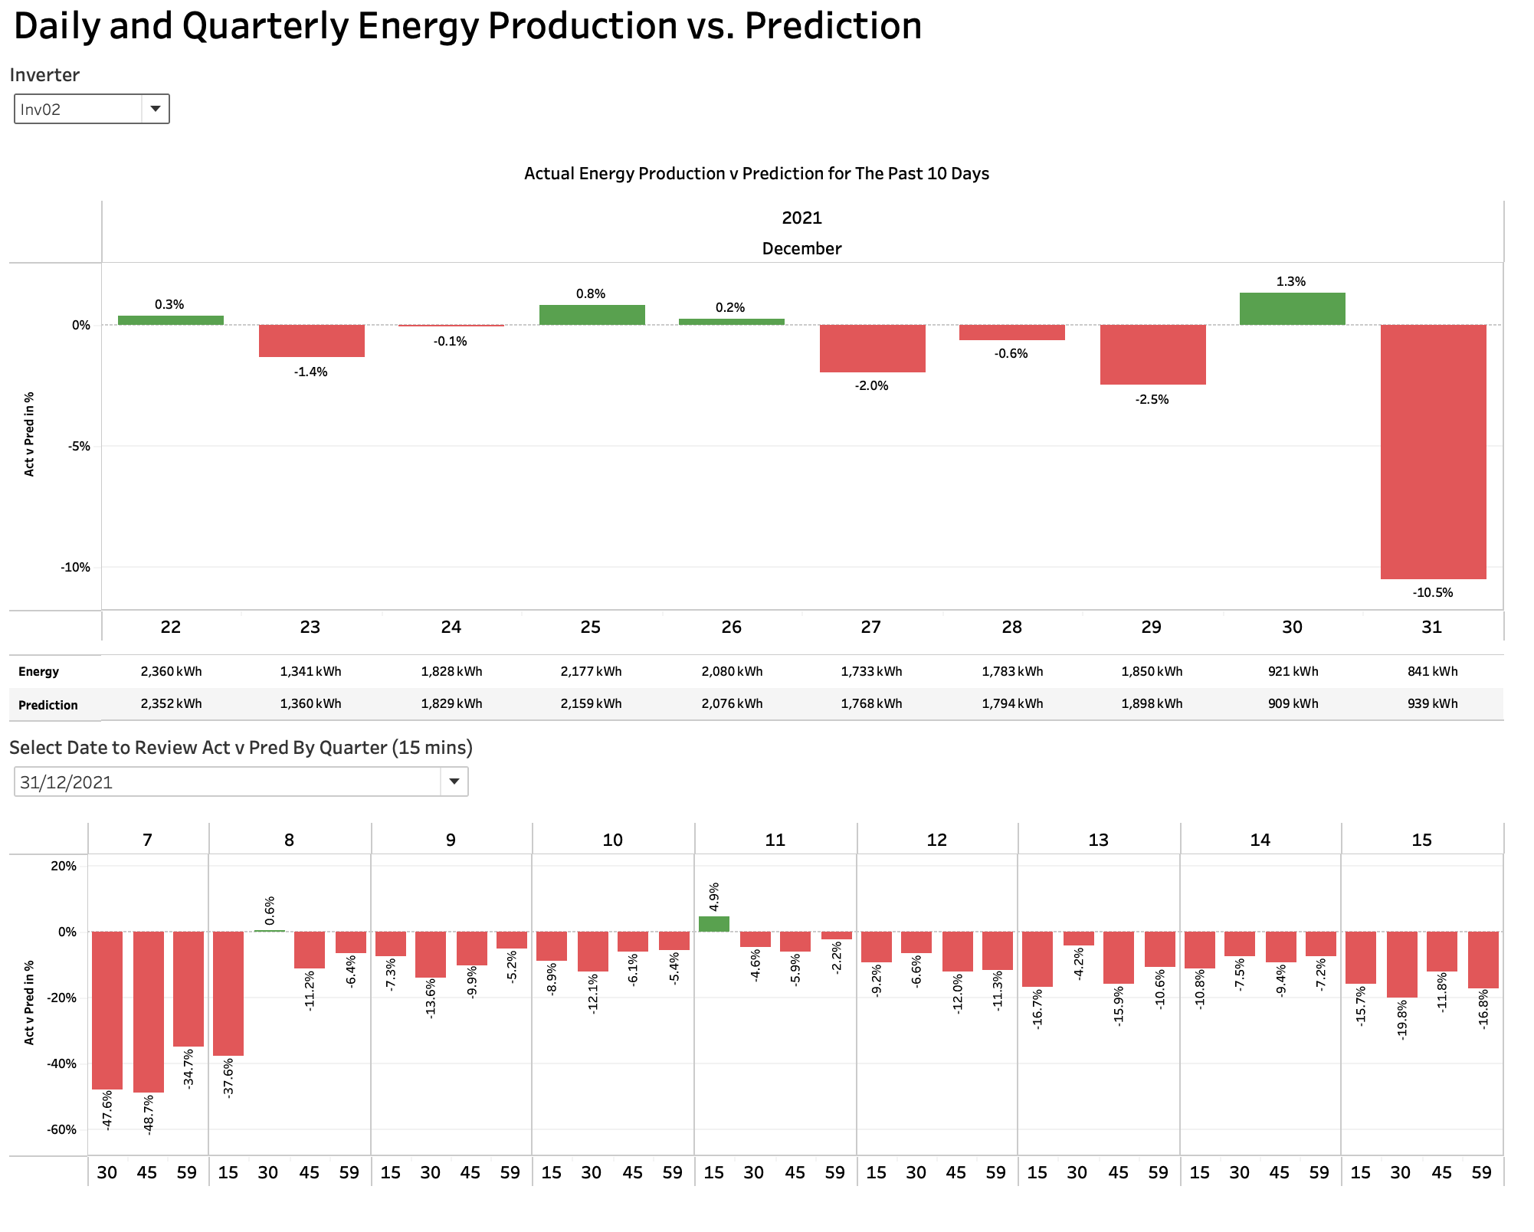
Actual vs. Prediction
Prediction has been calculated by applying ML models
Select an inverter or multiple inverters to review actual energy production vs. predictions
You can use this summary to help abnormal detection if the inverter produced less energy than prediction constantly
Notes:
With the help of machine learning models, we also include an actual verse prediction summary, it shows the deviation from prediction in percentage. Users can see inverters below prediction constantly (18s)

Slide 19
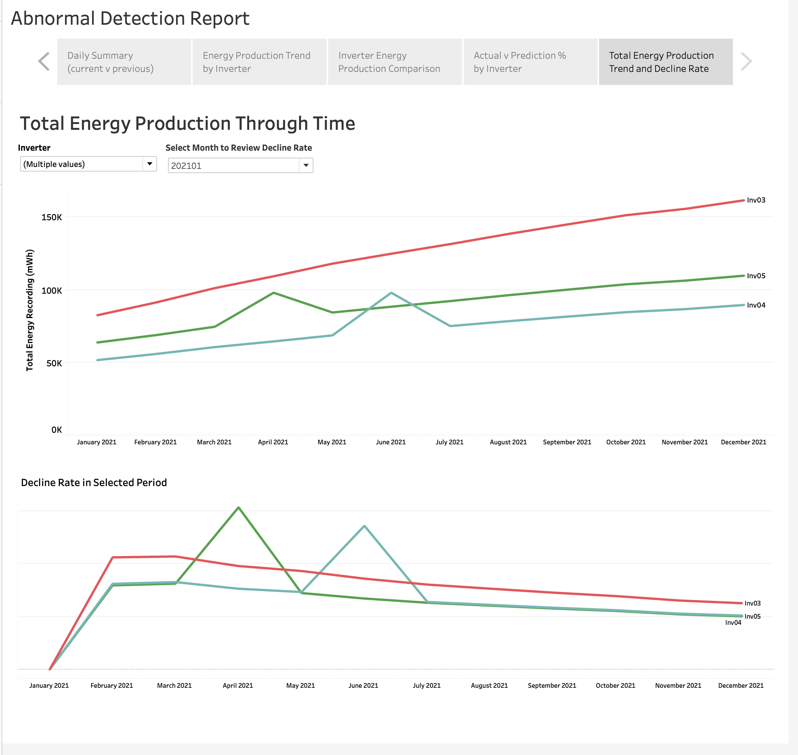
Total energy production trend and decline rate
From the last summary, you can select inverters and starting period to review the total energy produced overtime and the rate of decline overtime
The inverter show flat trend means energy production ability decline faster
The bottom chart can give you the idea when the inverter start producing less power
Notes:
Finally, the total energy production trend summary will not only show when the performance start declining, but also show which inverter failing faster.
By going though all components in our report, the users can get a complete overview of plant operation, identify inverters produce unexpected low energy and failing faster, detected abnormal quickly and setup an optimal plan for investigation in time(27s)

Slide 20


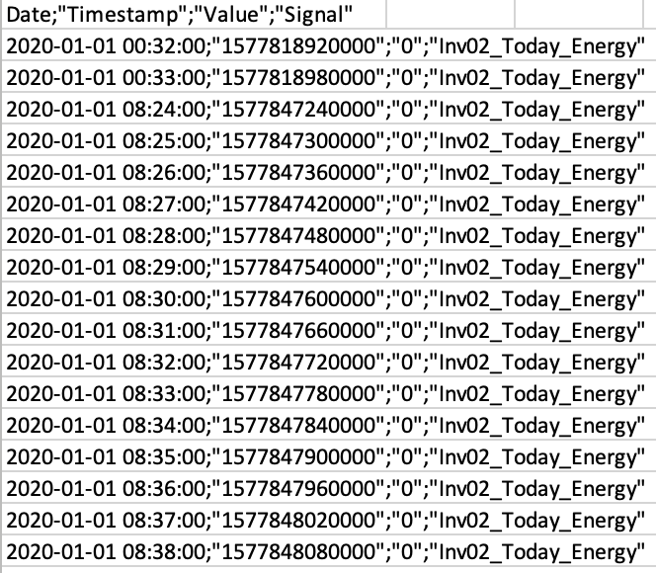
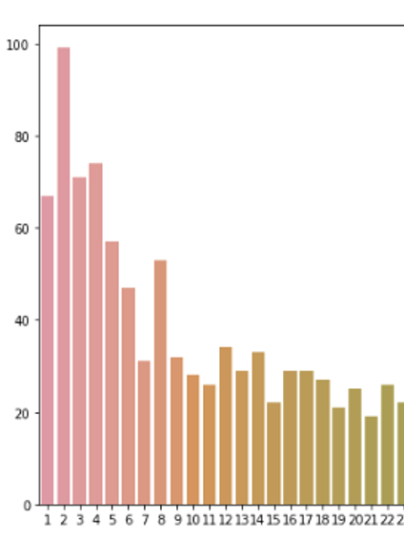
Current status
Daily abnormal detection report with semi-automatic updating process
+
15 mins Labour
Tableau subscription
Hypotheses testing
ML model implementation
Raw data
Data exploration
Daily abnormal detection report
Notes:
Through our work, we have tested it’s possible to get a functional abnormal detection report from raw data
The current semi-automatic updating process require 15 mins labour plus Tableau subscription (14s)

Slide 21

Future outlook
Use cloud computing to automate updating process
Notes:
Moving forward, with extra costs, we can apply cloud computing to automate the working process. (11s)

